Slide 1


A Remastered Analysis of Charitable Gaming by: Liam McMahon

Slide 2
Agenda
What is GDQ?
AGDQ vs. SGDQ
Donation Incentives
Console Wars
Linear Regression Modeling
Conclusions
Next Steps

Slide 3
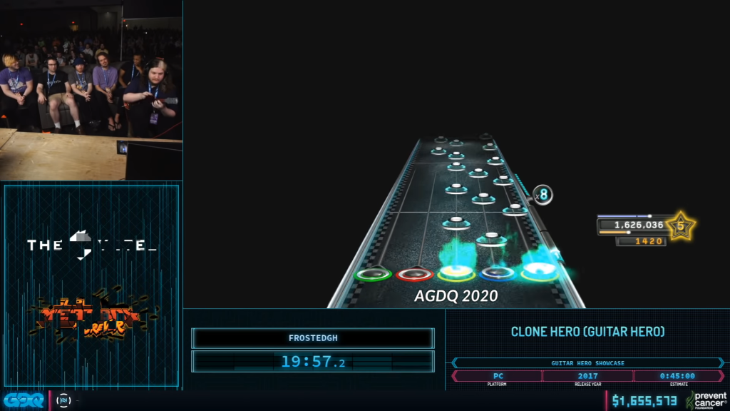


What is GDQ?
Games Done Quick (GDQ) is a series of charity video game fundraising events featuring high-level gameplay
To date, GDQ has raised over 50 million dollars for charities, including Doctors Without Borders and the Prevent Cancer Foundation
Sources: https://www.twitch.tv/gamesdonequick, https://gamesdonequick.com/

Slide 4
AGDQ vs. SGDQ

Slide 5
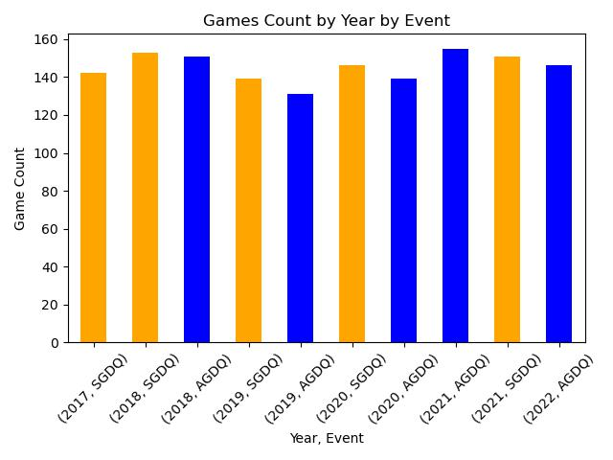
AGDQ vs. SGDQ, fight!
GDQ has two main events:
Awesome Games Done Quick (AGDQ)
Summer Games Done Quick (SGDQ)
24/7 marathons lasting a week.
AGDQ happens in January each year.
SGDQ happens during the summer each year.

Slide 6
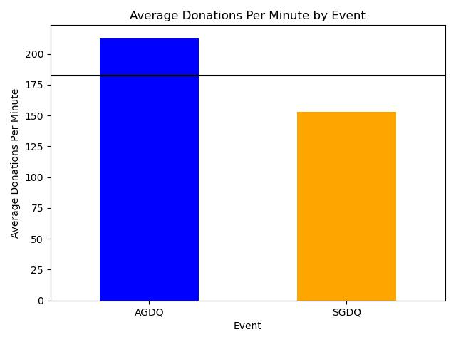
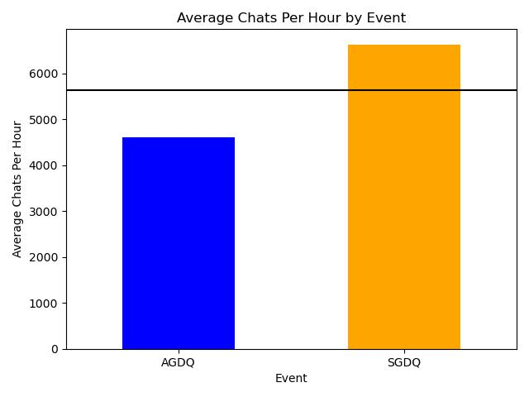
AGDQ vs. SGDQ, round 2!

Slide 7
Donation Incentives

Slide 8
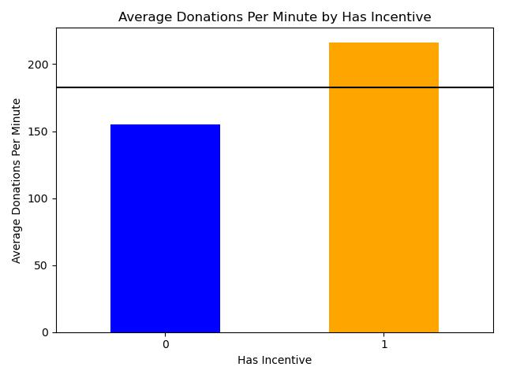
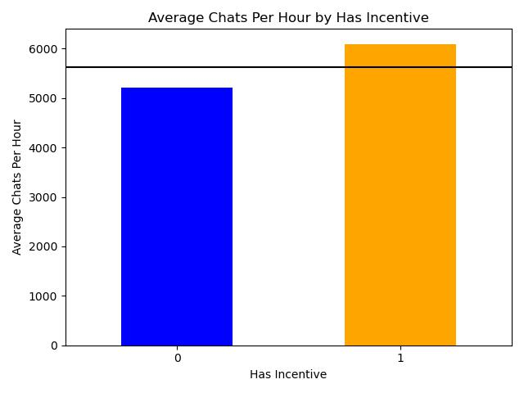
Donate? What’s in it for me, personally?

Slide 9
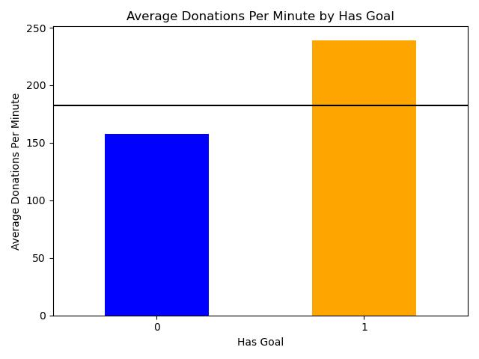
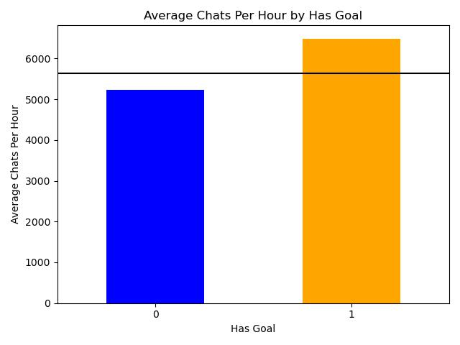
Wait, you want how much?

Slide 10
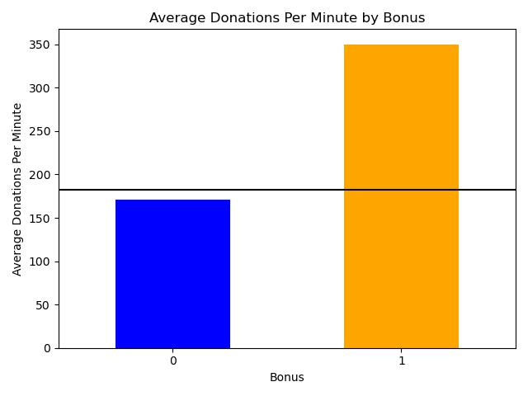
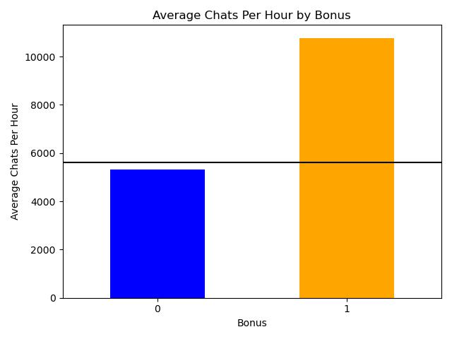
Bonus Games!

Slide 11
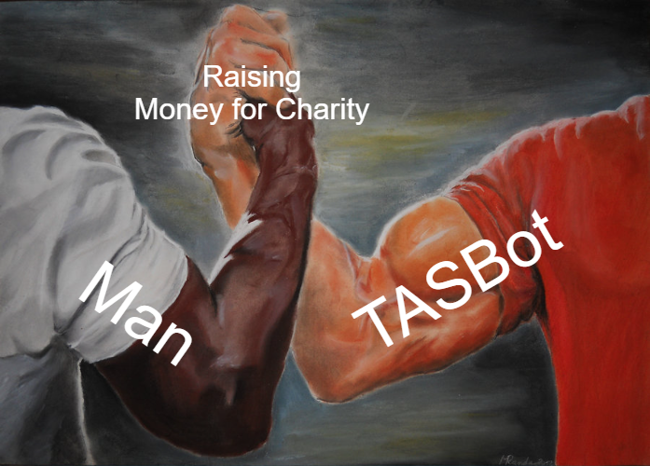
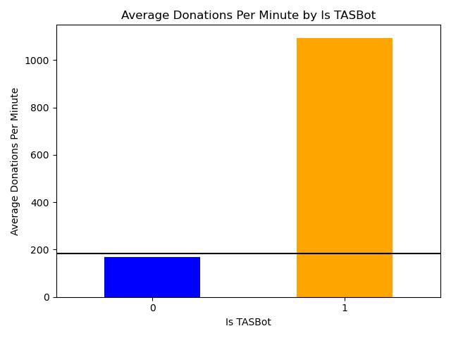
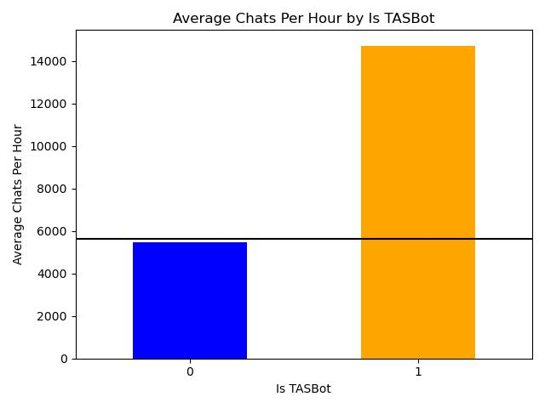
TASBot* joins the fray! *Tool-Assisted Speedrun Bot

Slide 12
Console Wars

Slide 13
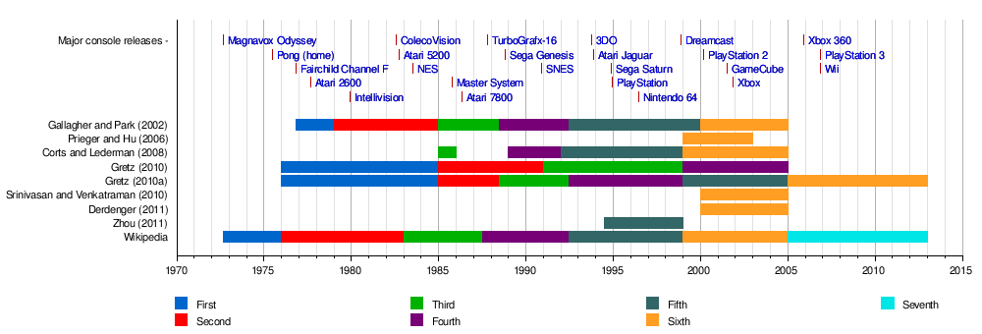
Warring Consoles: A Generational Conflict
We’re currently on the 9th Generation of video game consoles:
PlayStation 5
Xbox Series X
Nintendo Switch
https://en.wikipedia.org/wiki/History_of_video_game_consoles

Slide 14
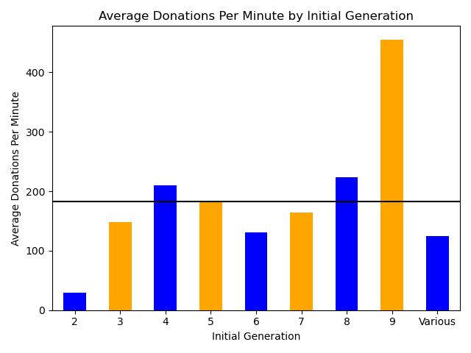
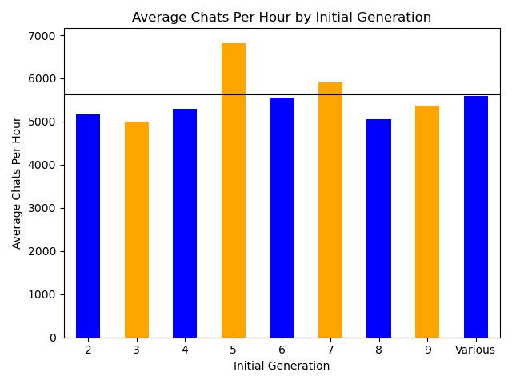
There’s always money in the new games…

Slide 15

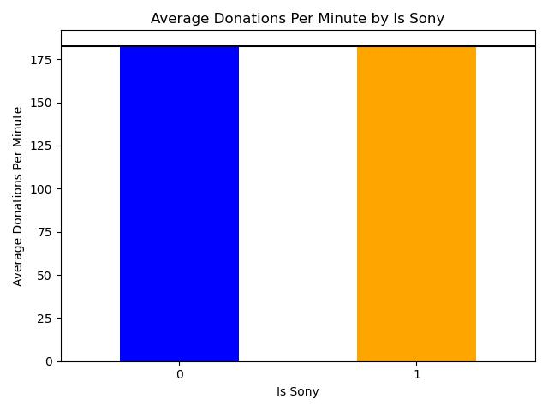
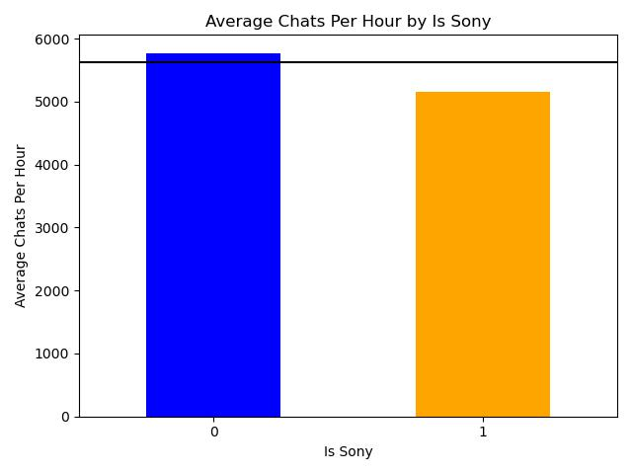
Sony Consoles

Slide 16

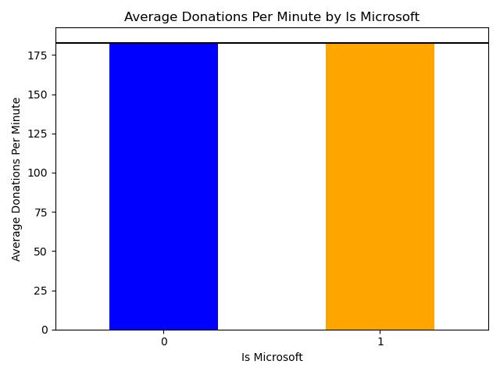
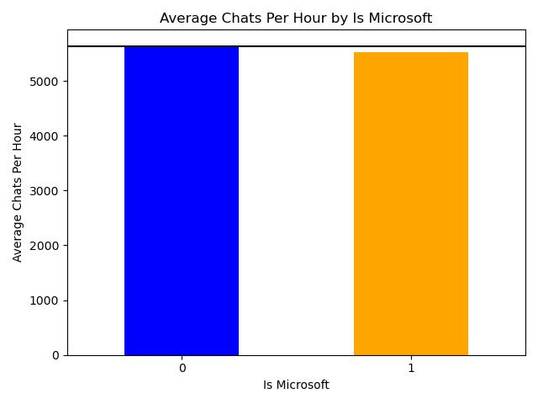
Microsoft Consoles

Slide 17
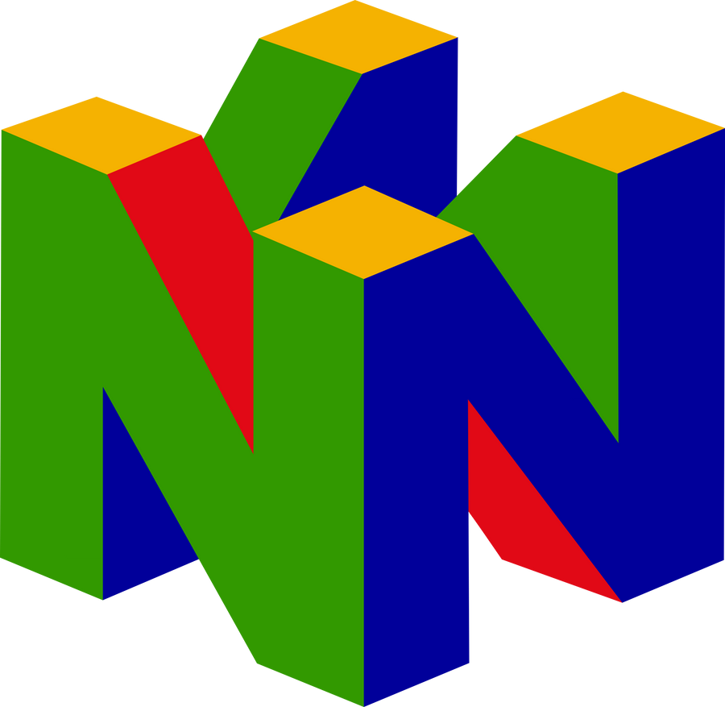
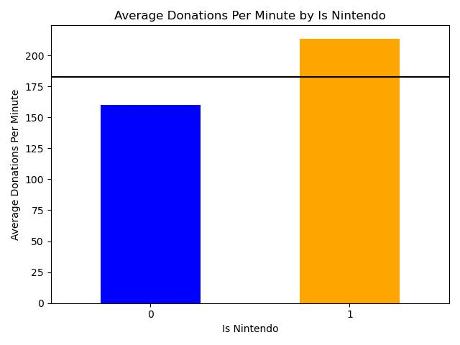
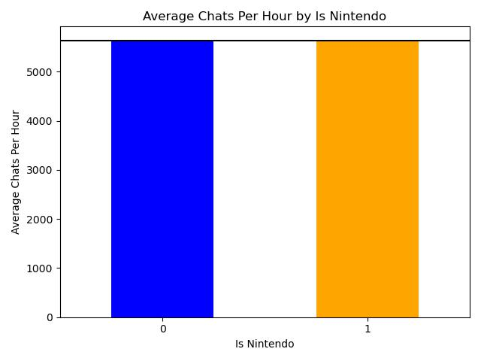
Nintendo Consoles

Slide 18

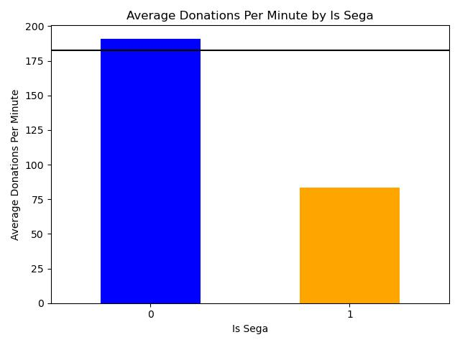
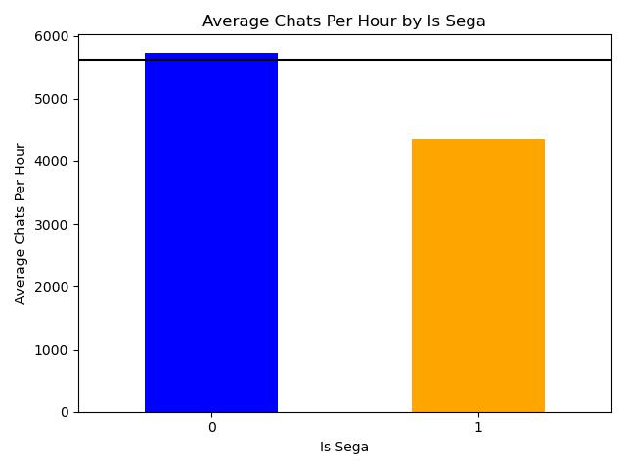
Sega Consoles

Slide 19

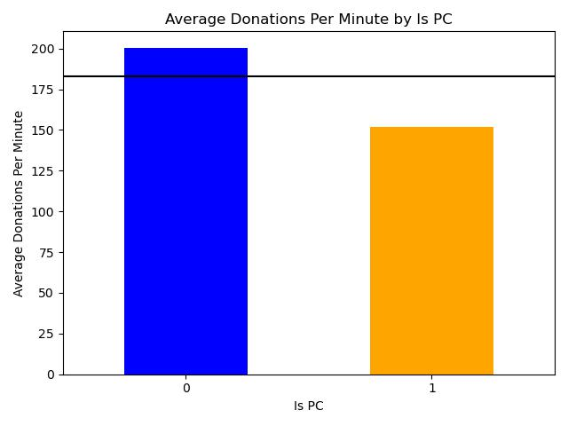

Personal Computer (PC)

Slide 20
Linear Regression Modeling

Slide 21
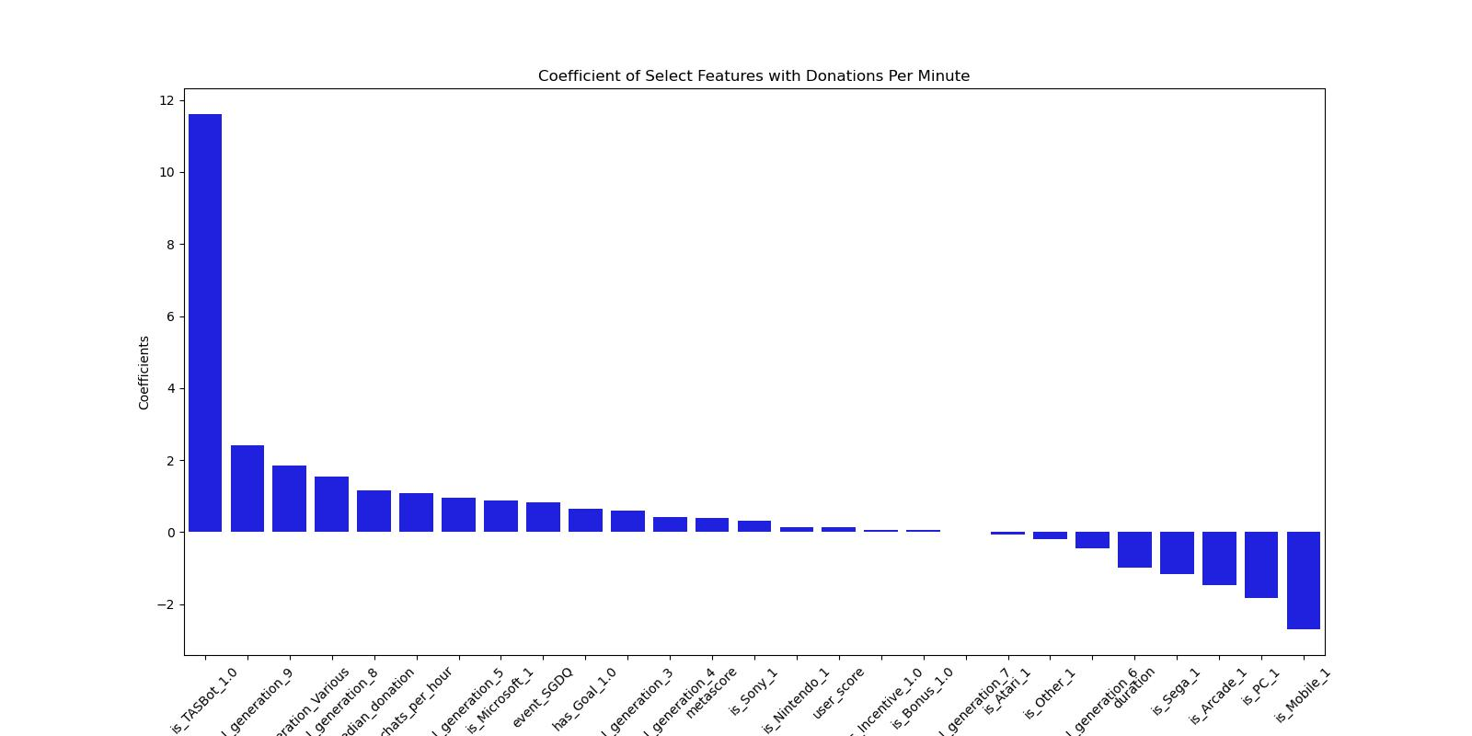
Linear Regression Model Performance
Test R²: 0.59
Used square root of target variable to reduce variance
is_TASbot and initial_generation_9 are the strongest positive features
is_Mobile and is_PC are the strongest negative features

Slide 22
Conclusion
To solicit the most donations for each event, the GDQ schedulers should focus on:
Incorporating newer games
Showcasing TASBot runs
Limiting the amount of mobile, arcade, and older games
Using goal incentives
Scheduling with time-of-day and day-of-week in mind

Slide 23
Limitations & Next Steps
Limitations:
Proper (incentive) donation attribution during previous games
Off-topic and/or untimely reviews (brigading, bad patches, etc.)
Data quality and availability
Next Steps:
Gather remaining GDQ data
Create additional salient features
Focus on timeseries aspect of data
Sentiment analysis on chat and donation comments

Slide 24

Thank you! Questions?
https://www.twitch.tv/gamesdonequick/
https://gamesdonequick.com/

